Slide 1
Leading with Lean Workshop

Slide 2

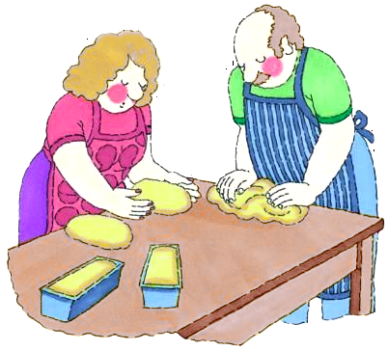

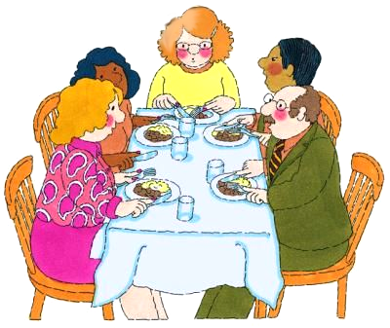
Leading With Lean
THE CHICKEN STORY
The next time they were together with the mother and grandmother, the husband asked the mother.
Their first conflict came about when the wife cut both ends off a chicken before she cooked it.
A newlywed couple agreed to share household responsibilities.
He then asked the grandmother…
I cut both ends because I never had a pan big enough!
Why do you cut off both ends of a chicken before cooking it?
That’s how you cook chicken.
That’s how my mother taught me to cook chicken.
Why?
That’s how my mother and grandmother taught me to cook.
Why do you cut both ends of the chicken?
Why do you cut both ends of the chicken?
Notes:
Speaker Notes: NA Speaker instructions: Hit a key to proceed.

Slide 3
Leading With Lean
THE CHICKEN STORY
So, the morale of the story is:
Understand the logic and rationale behind every process
step rather than just accepting it as it comes.

Slide 4
Agenda
LEAN at Syntel
WASTE
LEAN TOOLS
6S
VALUE ADD & VALUE
STREAM MAP
CAUSE & EFFECT DIAGRAM
PARETO
POKA YOKE
TAKT Time
KANBAN
HEIJUNKA
5 WHYS
PROJECT CHARTER
LEAN SUCCESS STORIES
Notes:
Speaker Notes: NA
Instructions to speaker:
Hit a key to display the text

Slide 5
Introduction To Lean
Lean is a philosophy that focuses on continuous elimination
of waste, inconsistency and unreasonableness
within our organization, using a set of tools and guidelines.
Waste: Any activity that consumes resources for which
the customer is not willing to pay.
Customer: Internal & External Customers
Notes:
Speaker Notes: NA

Slide 6
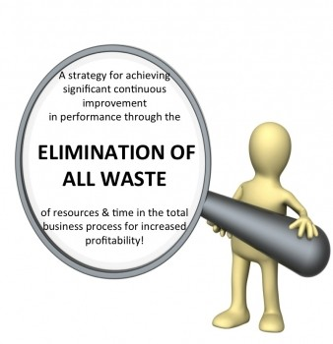
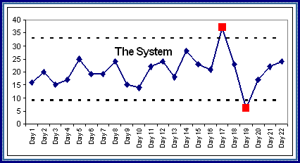

The 3 Ms Of Lean
Muda - Waste
Mura - Inconsistency
Muri - Unreasonableness
Notes:
Speaker Notes: NA
Speaker Instructions:
Hit a key to display the text Muda, Mura and Muri one after another.
Hit a key to display the table.

Slide 7














Lean – Why Is It Required?
Benefits
Productivity
Customer satisfaction
Profit
Responsiveness to Customer
Capacity
Quality
Cash flow
On time delivery
Cost
Defects
Lead time
Inventory
Space
Waste!
Relentless Focus on Reducing Waste
Notes:
7

Slide 8
LEAN Principles
Quality
Time
Cost
Morale
Culture
Energize & Empower
Flow / Pull
Allow work to flow and let customers pull our value added work
Quality at the Source
Do it right the first time,
every time
Voice of Customer
Understand requirements
Systems Thinking
Understand interdependencies
Proactive Behavior
Seize the opportunity
Constancy of Purpose
Unified direction
Respect for People
Respect for thoughts and views
Pursuit of Perfection
Create perfect value with no waste

Slide 9
Idea Junction - Flow

Slide 10
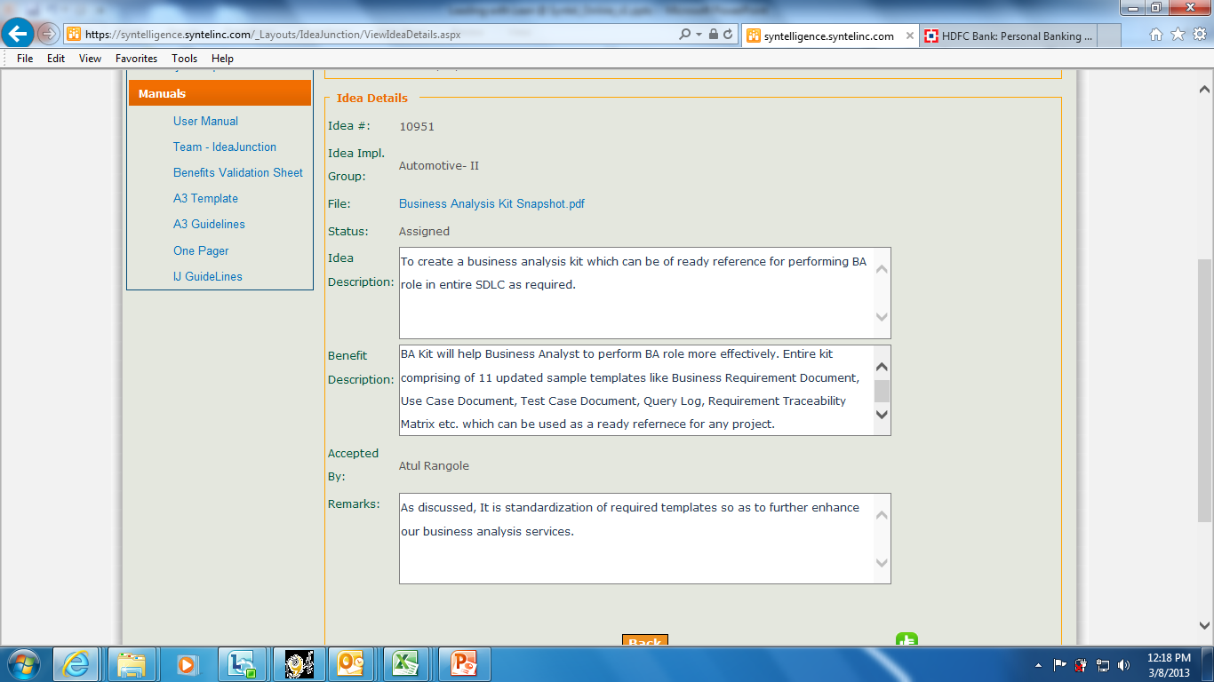
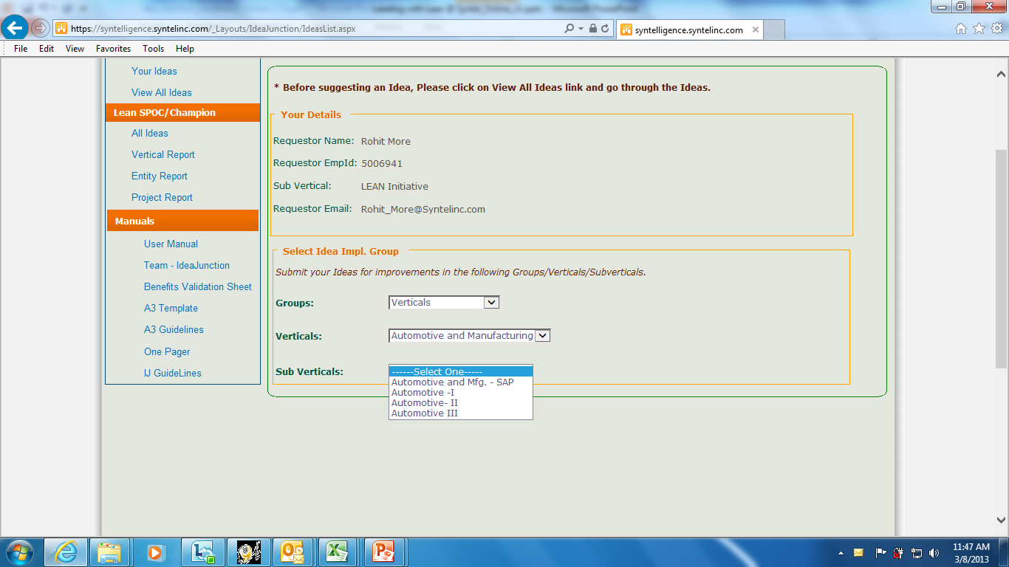
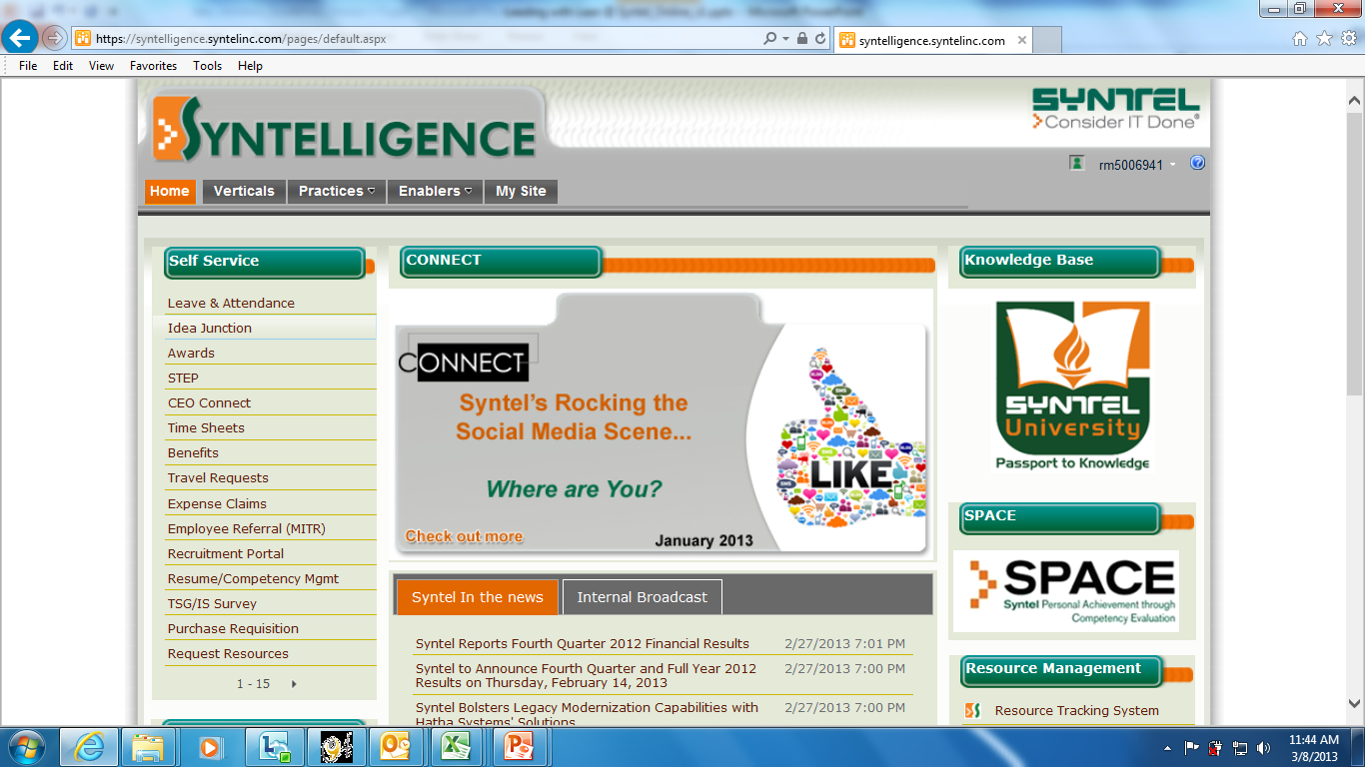
Idea Junction

Slide 11

Evolution Of Lean
Lean history
Henry Ford started assembly line production at Highland Park (1900s)
Shigeo Shingo and Taichi Ohno developed the Toyota Production System (1940s)
Richard Schonberger and Kiyoshi Suzaki introduced the World Class Manufacturing System (1980s)
James Womack’s ‘Lean – The Machine that Changed the World’ catapults Lean into the forefront of production (1990)
1900
1940
1980
1990
Notes:
Speaker Instructions:
- Hit a key to display the details corresponding to 1900s.
Speaker Notes:
In the early 1900s, Henry Ford started the Highland Park plant where assembly line production was pioneered.
Speaker Instructions:
- Hit a key to display the details corresponding to the second time span.
Speaker Notes:
The Toyota production system was developed between 1945 and 1970 by Shigeo Shingo and Taichi Ohno.
Speaker Instructions:
- Hit a key to display the details corresponding to the third time span.
Speaker Notes:
Richard Schonberger wrote a book called ‘Japanese Manufacturing Techniques’ in 1982. Later a book named ‘New Manufacturing Challenge’, written by Kiyoshi Suzaki was published in the year 1987.
Speaker Instructions:
- Hit a key to display the details corresponding to the fourth time span
Speaker Notes:
In 1990 James Womack wrote a book called ‘The Machine that Changed the World’.

Slide 12
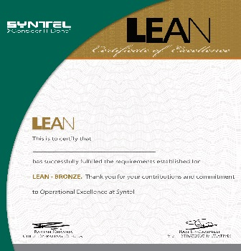

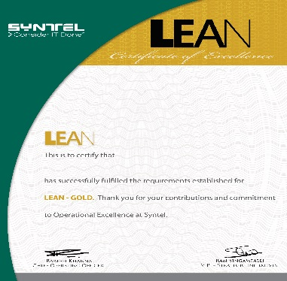
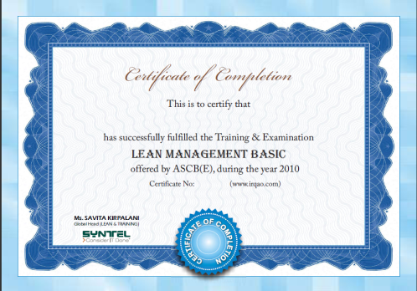
Lean Certification At Syntel
Attend a 3 Hr Lean awareness session
Attend a 1-day Lean basic training
Bronze
Silver
Participate in 1 improvement project
Participate in 3 improvement projects
Participate in 5 improvement projects
Lead at least 1 improvement project
Gold
Conduct 3 Lean
awareness sessions
(3 Hrs each)
ASCB (E)
Notes:
Speaker Notes: NA

Slide 13
Agenda
WASTE
Notes:
Speaker Notes: NA
Instructions to speaker:
Hit a key to display the text

Slide 14
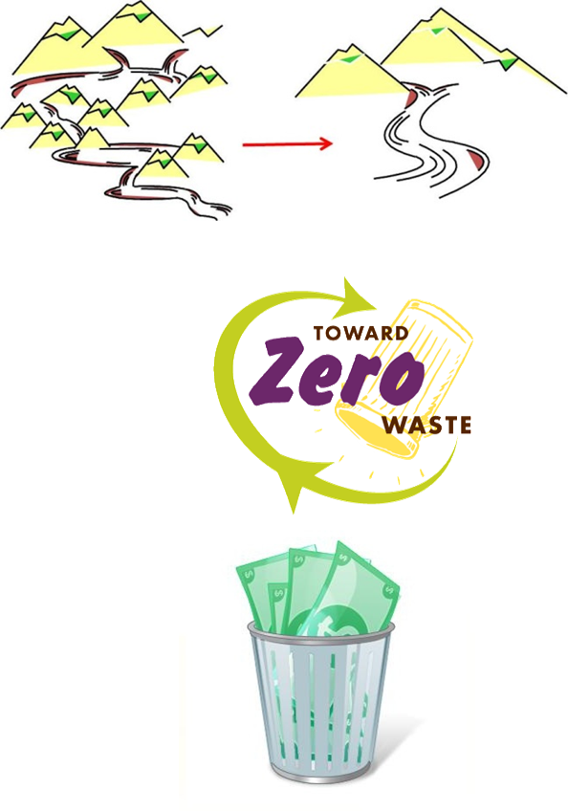

8 Types Of Waste
D
Defects
O
Over production
W
Waiting
N
Not utilizing Talent
T
Transportation
I
Inventory
M
Motion
E
Excess Processing

Slide 15
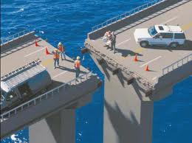
Types Of Waste
Defects
Anything that is not fit for use / deficiencies in service Output not meeting client’s expectation
Examples:
Missing a test case
Incorrect coding
Inadequate documentation
Not meeting SLA
Notes:
Speaker Notes: NA
Speaker Instructions:
Hit a key to display information about Five Ss and the bulleted points.
Hit a key to elaborate a bulleted point. Follow suit for each of the five Ss.

Slide 16

Types Of Waste
Motion
Any people movement that does not add value to the customer.
Examples:
Excess movement or to & fro caused due to handling multiple tasks at the same time
Segregated units
0
Notes:
Speaker Notes: NA
Speaker Instructions:
Hit a key to display information about Five Ss and the bulleted points.
Hit a key to elaborate a bulleted point. Follow suit for each of the five Ss.

Slide 17

Types Of Waste
Waiting
Waiting for anything – people, material, machine or information
Examples:
Waiting for website to open to download files
Waiting Approvals for downloads
Delays between coding and testing
Waiting for query resolution
Notes:
Speaker Notes: NA
Speaker Instructions:
Hit a key to display information about Five Ss and the bulleted points.
Hit a key to elaborate a bulleted point. Follow suit for each of the five Ss.

Slide 18


Types Of Waste
Not Utilizing Talent
Not using the existing knowledge, Leads to duplication of efforts
Examples:
Resources being hired but not being utilized
PM doing PL’s roles.
Forcing employee to work in a traditional way and opposing innovation
Using outdated method
When efficient techniques are available
Notes:
Speaker Notes: NA
Speaker Instructions:
Hit a key to display information about Five Ss and the bulleted points.
Hit a key to elaborate a bulleted point. Follow suit for each of the five Ss.

Slide 19

Types Of Waste
Transportation
Temporarily relocating and moving products/data.
Examples:
Documents getting reviewed by many departments but doesn't serve any purpose other than approval
Email exchanges between departments
Navigate through a series of applications for a repetitive task
Conveyance adds
no value
Notes:
Speaker Notes: NA
Speaker Instructions:
Hit a key to display information about Five Ss and the bulleted points.
Hit a key to elaborate a bulleted point. Follow suit for each of the five Ss.

Slide 20


Types Of Waste
Inventory
Inventory takes up space. It becomes obsolete if work requirements change.
Examples:
Data downloaded but not assigned
Requisition without budget approval
Having products but no corporate mandate to use them
Pending items queued up to be resolved
Buffer resources

Slide 21
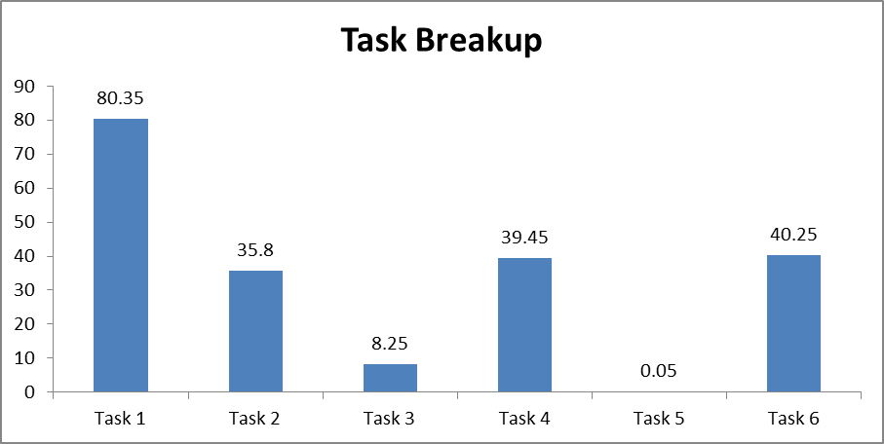
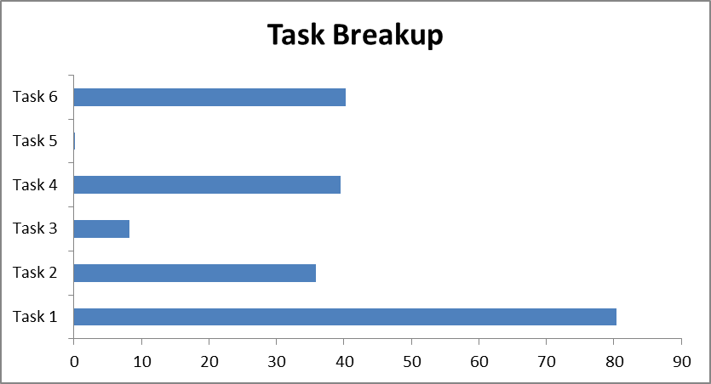
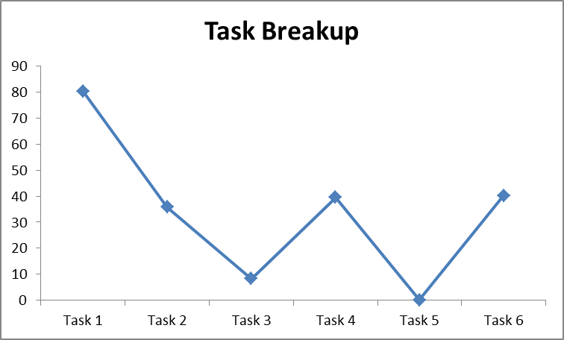
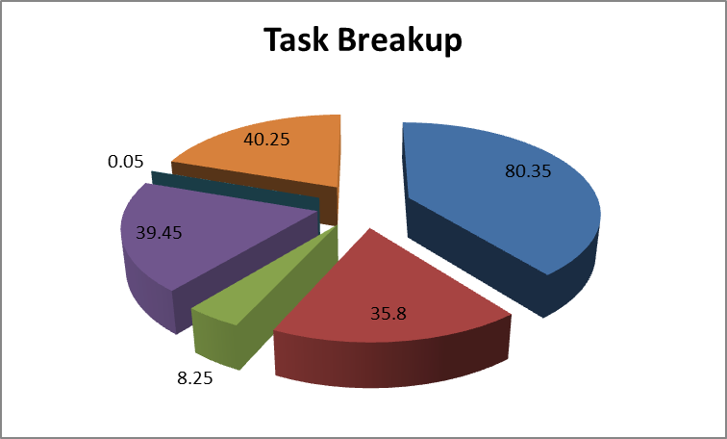
Types Of Waste
Over Production
Producing more than what is required to meet customer demand.
Examples:
Same functionality on multiple tools
Just-in-case work done without knowing customer’s requirements
Un-necessary features
Multiple reports with same data
Various reports with same data
Notes:
Speaker Notes: NA
Speaker Instructions:
Hit a key to display information about Five Ss and the bulleted points.
Hit a key to elaborate a bulleted point. Follow suit for each of the five Ss.

Slide 22
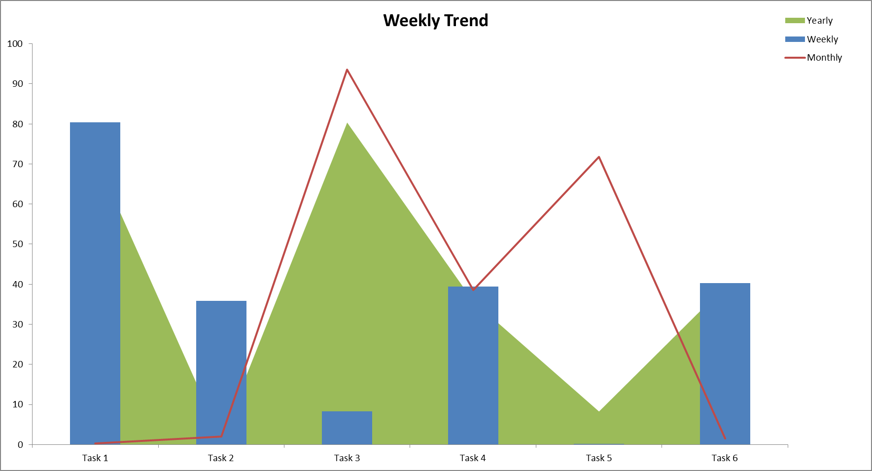
Types Of Waste
Excess Processing
Putting more work than required by the customer.
Examples:
Re-inventing the wheel, no standardization
Multiple levels of approvals
Adding extra information in the reports which is not required
Unrequired data in a report

Slide 23
QUIZ On Waste
Missed schedules
Changing from one task to another or looking for information etc
Developers waiting for requirements
Endless refinements to reports
Multiple forms with same information produced
Cross skilled resources not used
Documents moving from one department to another for approval
Software coded but not tested, lying in the system
DEFECT
MOTION
WAITING
EXCESS PROCESSING
OVER PRODUCTION
NOT UTILIZING TALENT
TRANSPORTATION
INVENTORY

Slide 24
Agenda
LEAN TOOLS
6S
VALUE ADD & VALUE
STREAM MAP
CAUSE & EFFECT DIAGRAM
PARETO
POKA YOKE
TAKT Time
KANBAN
HEIJUNKA
5 WHYS
Notes:
Speaker Notes: NA
Instructions to speaker:
Hit a key to display the text

Slide 25
What Is 6S?
The 6S principle helps maintain an efficient work place by minimizing waste.
Focus on 6S leads to:
Reduced costs
Reduced searching time
Improved quality
Customer confidence
Greater employee confidence/morale
Consistency in delivery
Notes:
Speaker Notes: NA

Slide 26
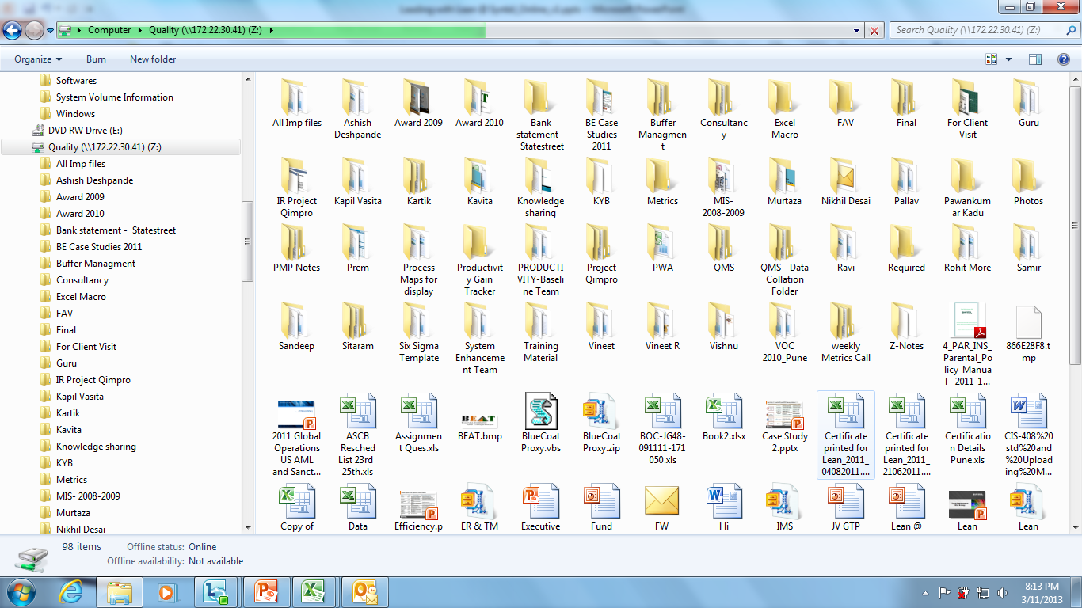
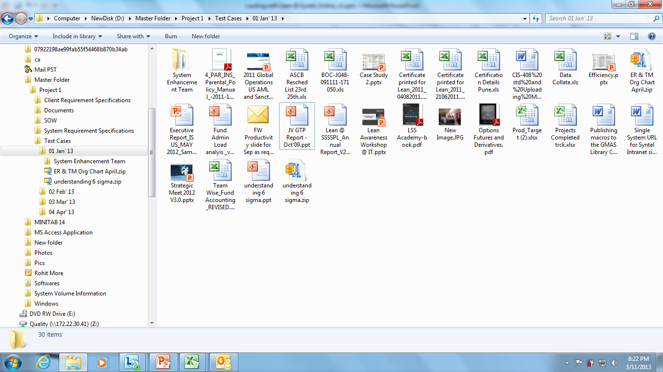
The 6S Principle
Sort (Seiri)
Focuses on eliminating unnecessary items from the workplace
Examples:
Tag unneeded items
Sort the equipment storage room
Use naming conventions to sort
files
Remove unnecessary files
Notes:
Speaker Notes: NA
Speaker Instructions:
Hit a key to display information about Five Ss and the bulleted points.
Hit a key to elaborate a bulleted point. Follow suit for each of the five Ss.

Slide 27
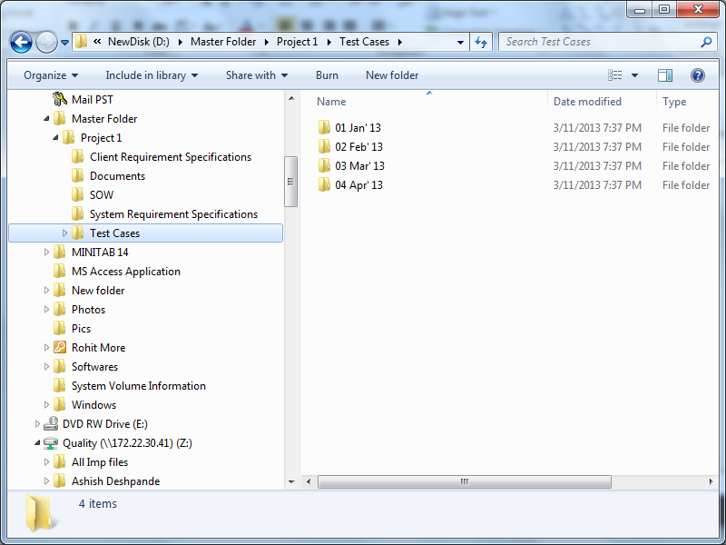
The 6S Principle
Set in Order (Seiton)
Focuses on efficient and effective storage ways ie. putting all necessary
items in good order
Examples:
Folder naming conventions
Keeping sharable items at central locations
Knowledge portals ordered as per usage
“A PLACE FOR EVERYTHING AND EVERTHING IN ITS PLACE”
Customary folder structure
And Designated folders

Slide 28
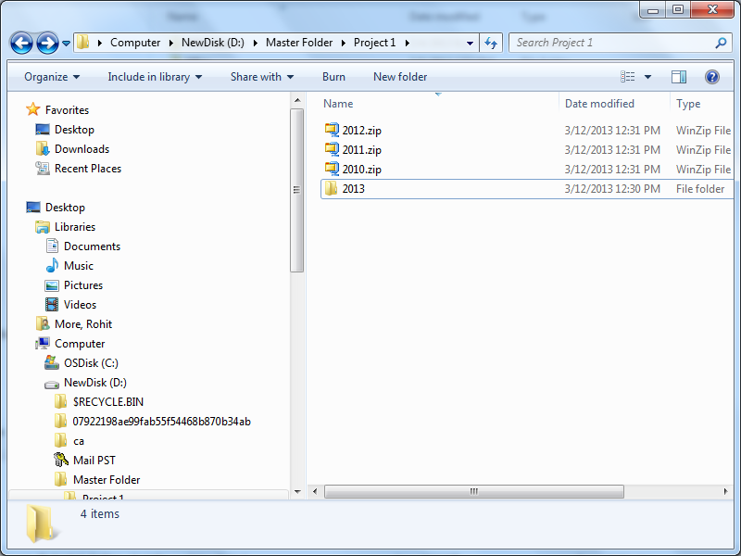
The 6S Principle
Shine (Seiso)
Focuses on keeping things clean and polished.
Examples:
Clean desks
Uncluttered mailbox
Updated knowledge
Archive expired data periodically
Notes:
Speaker Notes: NA
Speaker Instructions:
Hit a key to display information about Five Ss and the bulleted points.
Hit a key to elaborate a bulleted point. Follow suit for each of the five Ss.

Slide 29
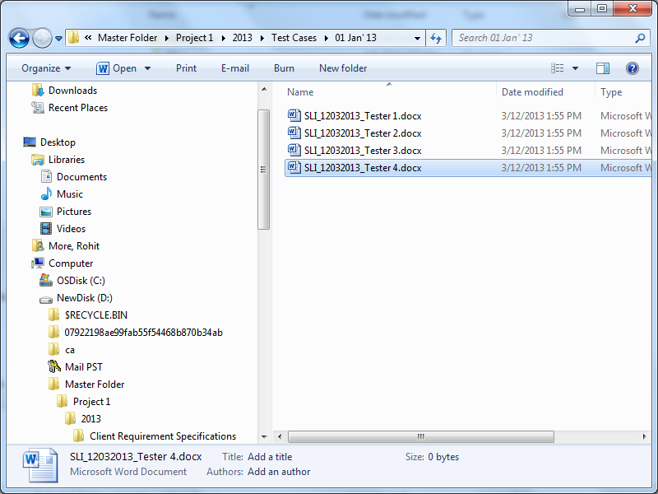
The 6S Principle
Standardize (Seiketsu)
Focuses on standardizing best practices at the workplace.
Examples:
Using Standard Operating Procedures - requirement for many Quality Management Systems and certifications like ISO, CMMI etc
Standardized Naming Convention
Notes:
Speaker Notes: NA
Speaker Instructions:
Hit a key to display information about Five Ss and the bulleted points.
Hit a key to elaborate a bulleted point. Follow suit for each of the five Ss.

Slide 30

The 6S Principle
Self-Discipline (Shitsuke)
It is a condition where all Members practice all the 5S’s as a way of life.
Accordingly, it is a CULTURE.
Examples:
Dash boards on weekly/monthly basis
Set Goals
Audit, Review and sustain. Replicate this practice across organization
Notes:
Speaker Notes: NA
Speaker Instructions:
Hit a key to display information about Five Ss and the bulleted points.
Hit a key to elaborate a bulleted point. Follow suit for each of the five Ss.

Slide 31
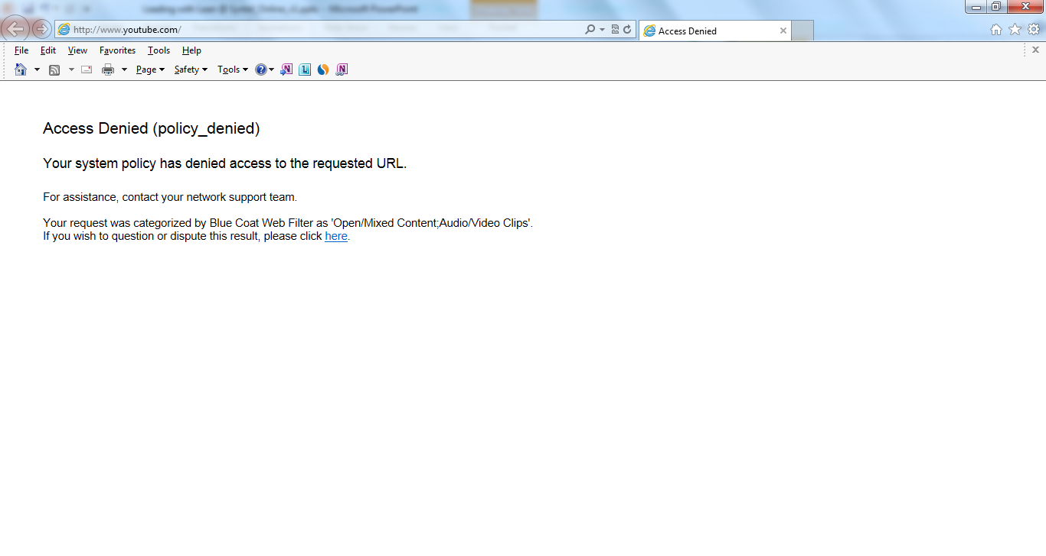
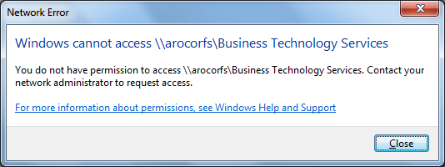
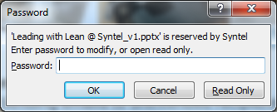
The 6S Principle
Safety (Anzen) - Information Security
Encompasses not just physical safety…but also security of information
and knowledge within the company
Examples:
Sending emails to unintended recipients
Unauthorised access to our system
Sharing customer confidential details
Visiting unauthorised website

Slide 32
Value Added Activities
Lean focuses on improving the proportion of Value Added activities and reducing the Non Value Added activities
Value Added (VA)
Product or service is transformed into a state required by the customer;
The customer is willing to pay for it
Non Value Added (NVA)
Activities which consume resources but do not create value;
Customer is not willing to pay for these
Non Value Added but Needed (NVAN)
Activities causing no value add but cannot be eliminated based on the current state of technology or thinking
A Time Value Map (TVM) depicts
breakup of VA, NVA & NVAN times
Process A

Slide 33
Value Stream Map
Value Stream mapping is an exercise to identify VA, NVA and NVAN steps in a process using well defined symbols
Secondary
Supplier
Supplier
Customer
Control
Customer
Customer
Contractor
Supplier
Customer
Primary
stage
Primary
Stage
Primary
Stage
Primary
Stage
Supplier
Supplier
Primary
Stage
Primary
Stage
Secondary
It can be simpler, smarter and quicker!’.
Primary
Stage
Secondary
Secondary
Supplier
Contractor
Customer
Customer
Secondary
Primary
Stage
Site 1
Site 2
Site 3
Site 4
Secondary
Customer
Customer
Primary
Stage
Secondary
Contractor
Client (input)
Primary
Europe
N.America
International
Contractor
Customer
Primary
Stage
Customer
Notes:
Speaker Notes:
NA
Speaker Instructions:
Hit an arrow key (s) to display text.
Continued on the next screen.

Slide 34
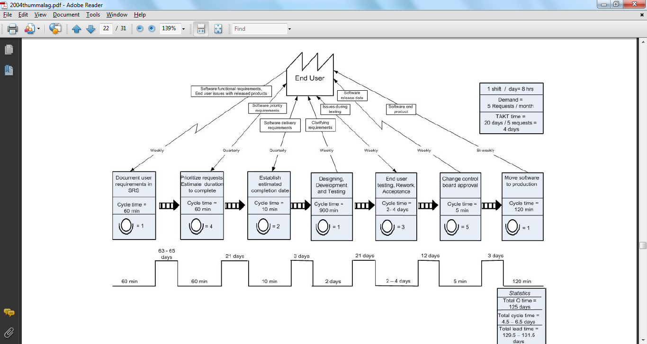
Value Stream Map – Current State Example

Slide 35
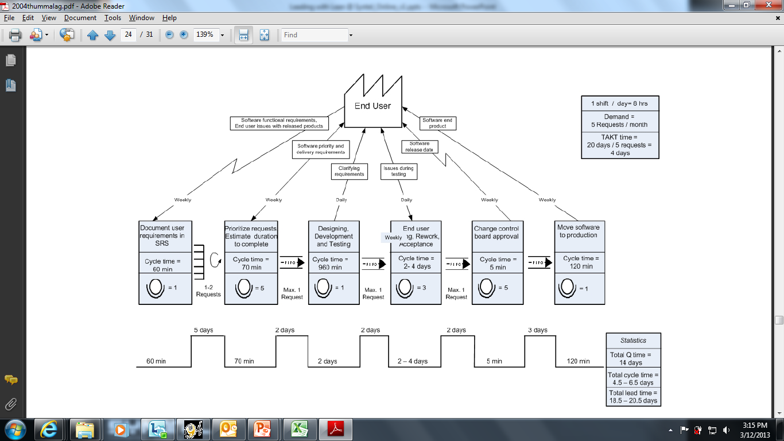
Value Stream Map – Future State Example

Slide 36
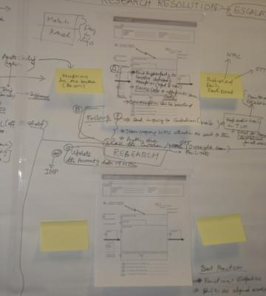
Value Stream Map
Actual VSM done
In KPO
Notes:
Speaker Notes: NA

Slide 37
Cause & Effect Diagram
A method of identifying all potential causes that may be contributing to the problem (i.e. effect)
A cause and effect diagram, also known as a fishbone or an ishikawa diagram, classifies all the causes into 6 preferred categories:
Machine - groups root causes related to tools used
Material - groups root causes related to information and forms needed to execute the process
Mother Nature - groups root causes related to our work environment, market conditions, and regulatory issues
Measure - groups root causes related to the process measurement
Method - groups root causes related to procedures, hand-offs, input-output issues
People - groups root causes related to people and organizations

Slide 38
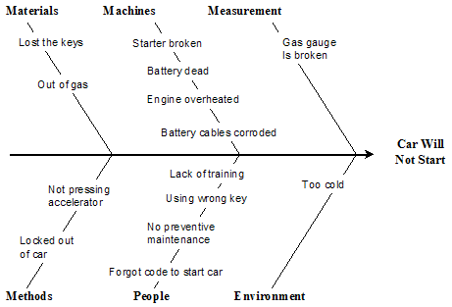
Cause & Effect Diagram – An Example
Mother Nature

Slide 39
5 Whys
Refers to the practice of asking questions 5 times, why an event occurred to get to the root cause of the problem
Example of 5 Why technique:
Problem: The daily production review revealed that one of our input had failed to load last night
Q1) Why?
Because it didn't match the data structure expected by our data loader (an extra
column had been added to the right-side of the file)
Q2) Why?
Because the group that supplies the data file had changed the structure
Q3) Why was the data structure changed?
To incorporate a new management request.
Q4) Why were we not told?
Because the supplying group had tested the change with all systems
that used the file and they weren't aware that we used the file
Q5) Why weren't they aware we used the file?
We had informed them, but there had been staff changes and they
didn't keep formal records
ROOT
CAUSE

Slide 40
The Pareto Principle
‘A small number of causes is responsible for a large percentage of the effect’
The Pareto Principle is often known as ‘The 80-20 rule’:
80% of the decisions made in meetings occur in 20% of the meeting time
80% of the profits are derived from 20% of the market segments
80% of manager’s interruptions come from the same 20% of people
The Pareto Principle helps scope problems down to manageable size
Notes:
Highlight: the Pareto Principle demonstrates that the ‘Vital Few’ can be separated from the ‘Trivial Many’, to allow the focus to center on the highest leverage aspects. This is the reason why the Pareto Principle one of the key scoping tools for identifying Lean projects.

Slide 41
An Example Of A Pareto Chart
A Pareto Chart helps us to prioritize the aspects of the process that need to be looked at first
Vital Few
99%
100%
250
94%
97%
100%
88%
200
200
180
80%
80%
150
68%
Trivial Many
60%
100
40%
Number of Errors
68
36%
42
50
30
20%
15
11
9
0
A
B
E
0%
C
D
F
G
Others
A, B & C contribute to 80% of the errors

Slide 42
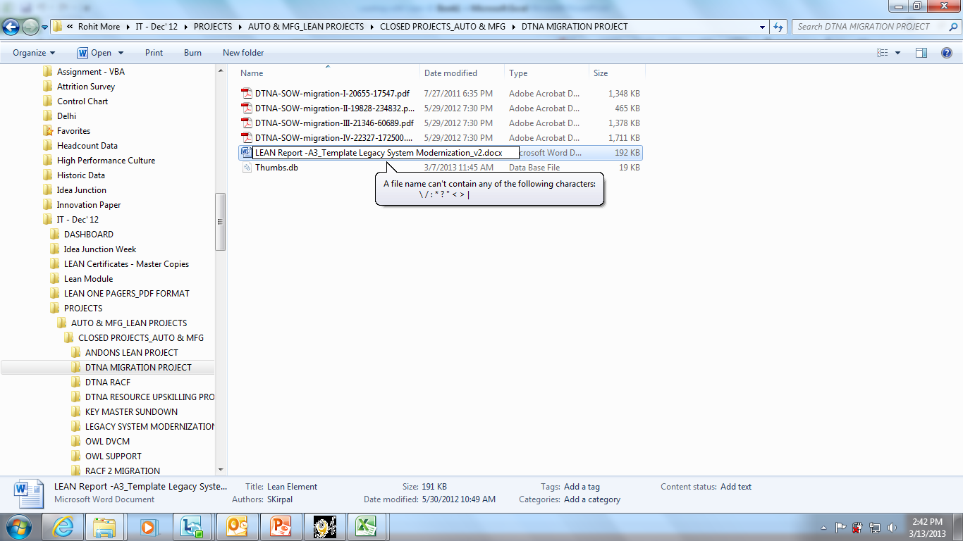
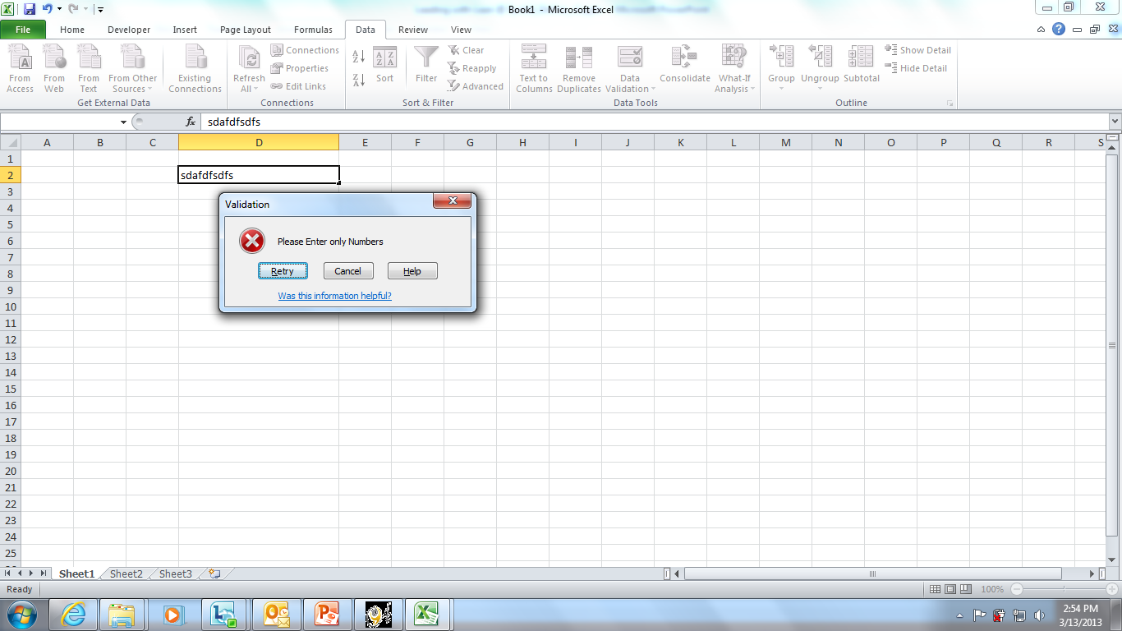
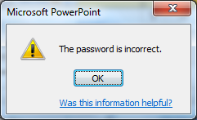
Poka Yoke
Yokeru – To prevent
Poka – Inadvertent errors
Simple, failsafe methods which prevent mistakes from being made or from becoming defects.
What does a Poka Yoke do?
Eliminates the cause of an error at the source;
Detects an error as it is being made;
Detects an error soon after it has been made but before it reaches the next operation.
From:
To:
“Errors are
inevitable!”
Paradigm shift
in thinking
required
“Errors can be
eliminated”
Notes:
Defects exist in two states. It is either about to occur, or it has already occurred. Actively search out the conditions that cause errors and eliminate them.
Search for Common defect causes
Defective
product
Processing
defect
Material
Defect
Setup error
Adjustment
error
Process
Omission
Process
error
Missing
parts
Incorrect
parts
Errors may be Human or Process related
Defects may be Repetitive or Unique

Slide 43
TAKT Time
TAKT time is the rate at which a process should be producing, in order to meet the customer’s demand.
TAKT time = Available time for production per day
Customer demand per day
The process will not meet customer demand if Cycle Time is greater than TAKT time….cause for ALARM
TAKT time is often called the heartbeat of production

Slide 44
TAKT Time Calculation Example
Available time for production per day
Customer Demand in that Time
TAKT Time =
Available time = 1 shift x 9 hours – (2) 15-min. breaks – (1) 30 minute lunch = 480 minutes/day
Customer DD 960 units/month
= = 48 units
Units/ day 20 days/month
480 minutes/day
TAKT time = = 10
minutes/unit 48 units/day
Therefore,
Cycle Time = 12 minutes, process will not meet customers demand
Cycle Time = 10 minutes, process is on schedule to meet customers demand
Cycle Time = 8 minutes, process is before schedule to meet customers demand

Slide 45
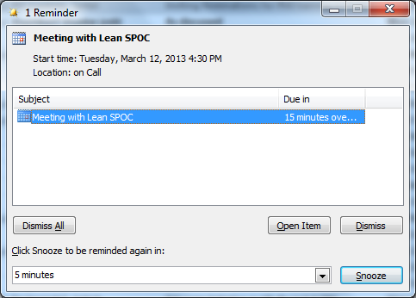
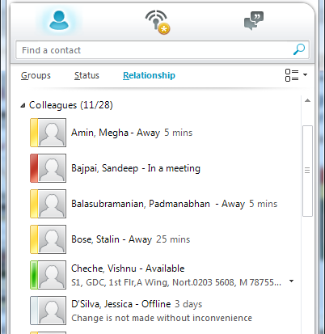
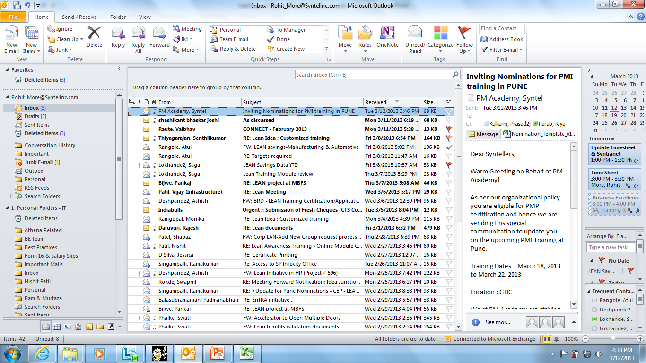
Kanban
Kan – Signal
Ban – Cards
Kanban is a signaling system. It uses cards to signal the need for an item.
Status on Lync uses kanbans with a color
coded signaling mechanism
Flagging mails to prioritize work
Different systems can be used instead of cards like flags, lights, emails, post its or macros

Slide 46
Heijunka
Heijunka means leveling of workflow – produce as per customer
demand, in small batches to result in optimum resource utilization
There are 2 types of heijunka:
Leveling of production by volume
Leveling of production by product type

Slide 47
Agenda
PROJECT CHARTER
Notes:
Speaker Notes: NA
Instructions to speaker:
Hit a key to display the text

Slide 48
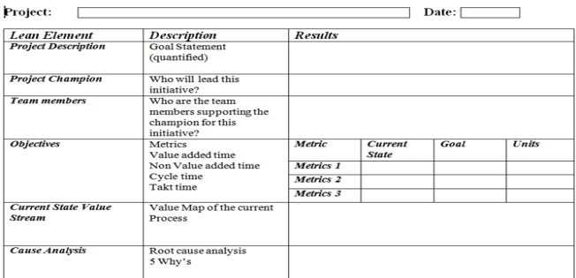
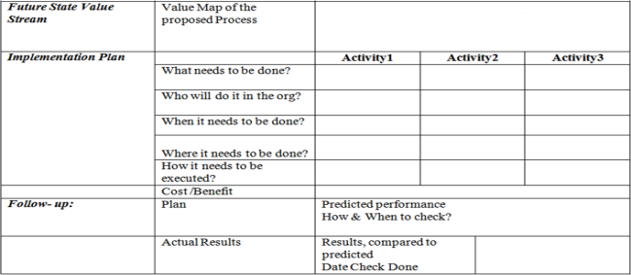
Project Charter - A3 Template
The A3 Report is a simple storyboard that tells the story of an
improvement project.
The project team records the results of investigation and planning in a concise
A3 format that facilitates knowledge sharing and collaboration.

Slide 49





LEAN Results Measurement
Learning &
Development
Innovation &
new capabilities
Customer &
Employee Satisfaction
Waste Elimination &
Cycle time reduction
Growth Top-line increase
Top line $s generated
$s saved in the current
calendar year
CSAT & SEEQ score
improvements
New service offerings
or new SLA
# Training days per employee, Employees released to other units

Slide 50

Question ?

Slide 51
